Slide 1
ONLINE CHARITY SYSTEM
BY: Umme Hani
Komal BR
Prakruthi S

Slide 2
ABSTRACT
The project is all about the creation of a website
for charity propose.
The primary purpose of the website is to communicate the
importance of helping fellow humans who suffer from various insufficiencies to all potential users of the website.

Slide 3
. HTML describes the structure of Web pages using markup.
. HTML tags label pieces of content such as heading, paragraph, table, and so on. Browsers do not display the HTML tags.
. Cascading Style Sheets (CSS) is a style sheet language used for describing the presentation of a document written in a markup language like HTML.
. Hypertext Preprocessor (or simply PHP) is a server-side scripting language designed for Web development, but also used as a general-purpose programming language.
. PHP code may be embedded into HTML code, or it can be used in combination with various web template.

Slide 4
Aim of the project
. Online Charity.com is web-based registration software that helps you to Sell and donate wastes online. It is an ideal for Home, Society, Industries, School, Hospitals, Factories, Retail Shop, Offices based.
. Online Charity.com is communicate the importance of helping fellow humans who this can be done through collaboration of the charity organization with event organizers and posting.

Slide 5
REQUIREMENTS
Software Requirements
Windows 7/10
My SQL database
Xampp Server
Hardware Requirements
Processor – Intel® Core™ i5-7200U CPU @ 2.50GHz2.70GHz
Main memory(RAM) – 4.00GB
System Type- 64-bit Operating System,x64-basedprocessor
Monitor –Generic PnP Monitor

Slide 6
DESIGN
Home
The user is redirected to this page once he/she is logged in. This is the main page of website where navigation to other pages is provided. This page provides glimpse of the website to customer.
Contact
In this section, we have provided the contact number and proper email address, so that the customers can anytime write to us with any queries or complaints. Also their valuable feedbacks are always heartily welcome. And our special team is ready to solve their problems and serve them the better way possible.
Blog
Here we can VIEW WHAT TYPE OF CHARITY WE ARE PROVIDING.I,E FACILITES FOR CHARITY

Slide 7
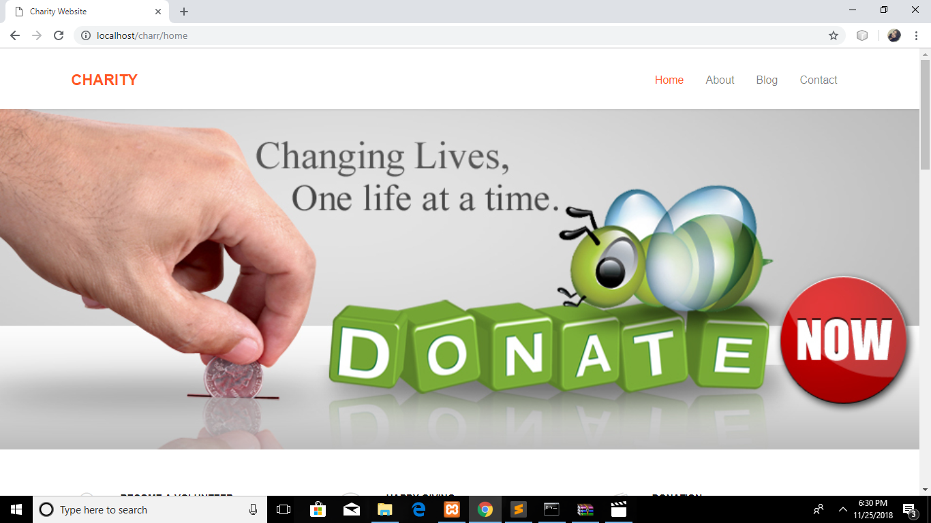
SCREENSHOTS

Slide 8
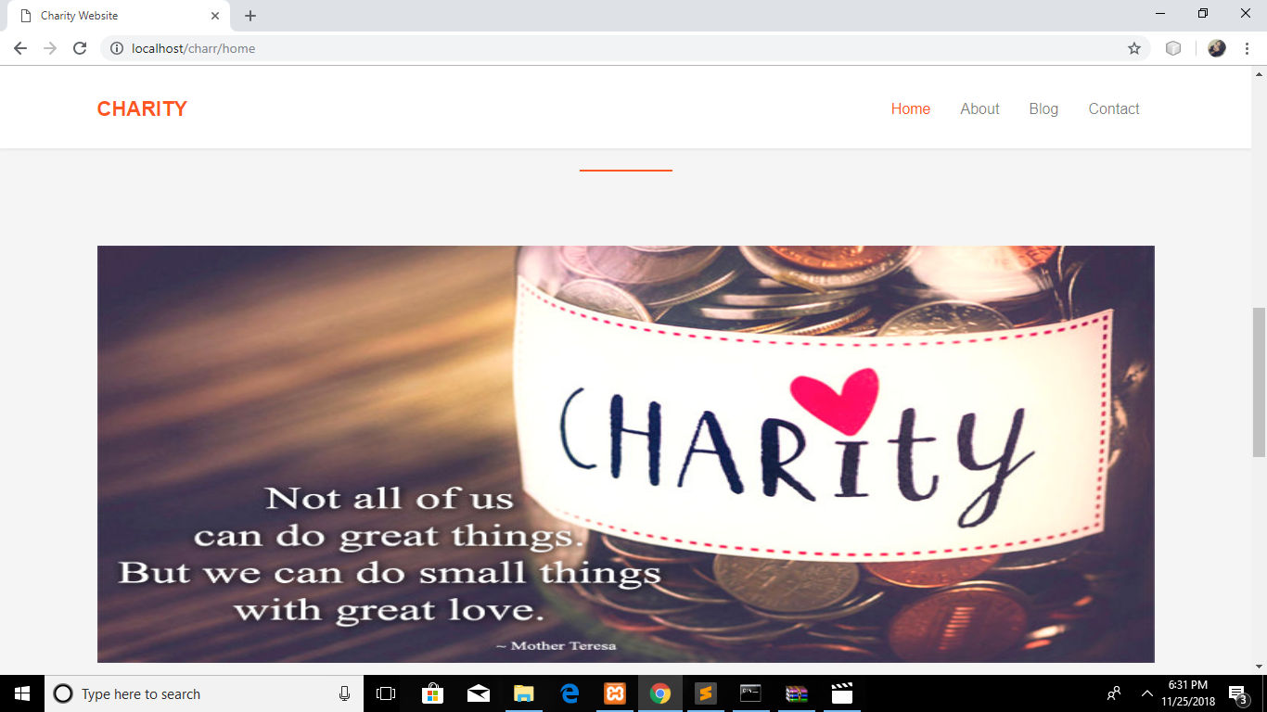

Slide 9
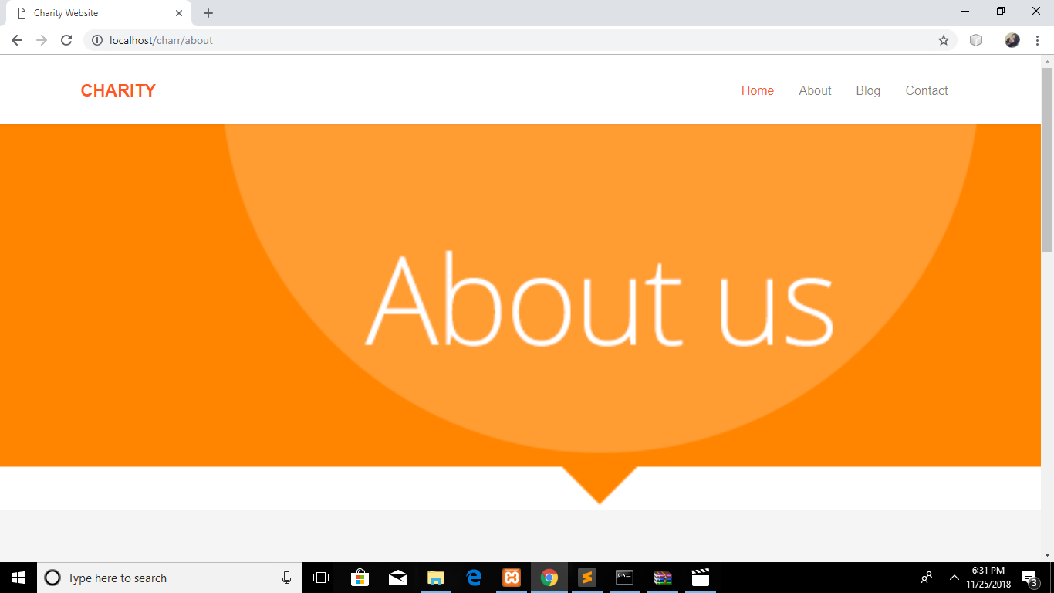

Slide 10
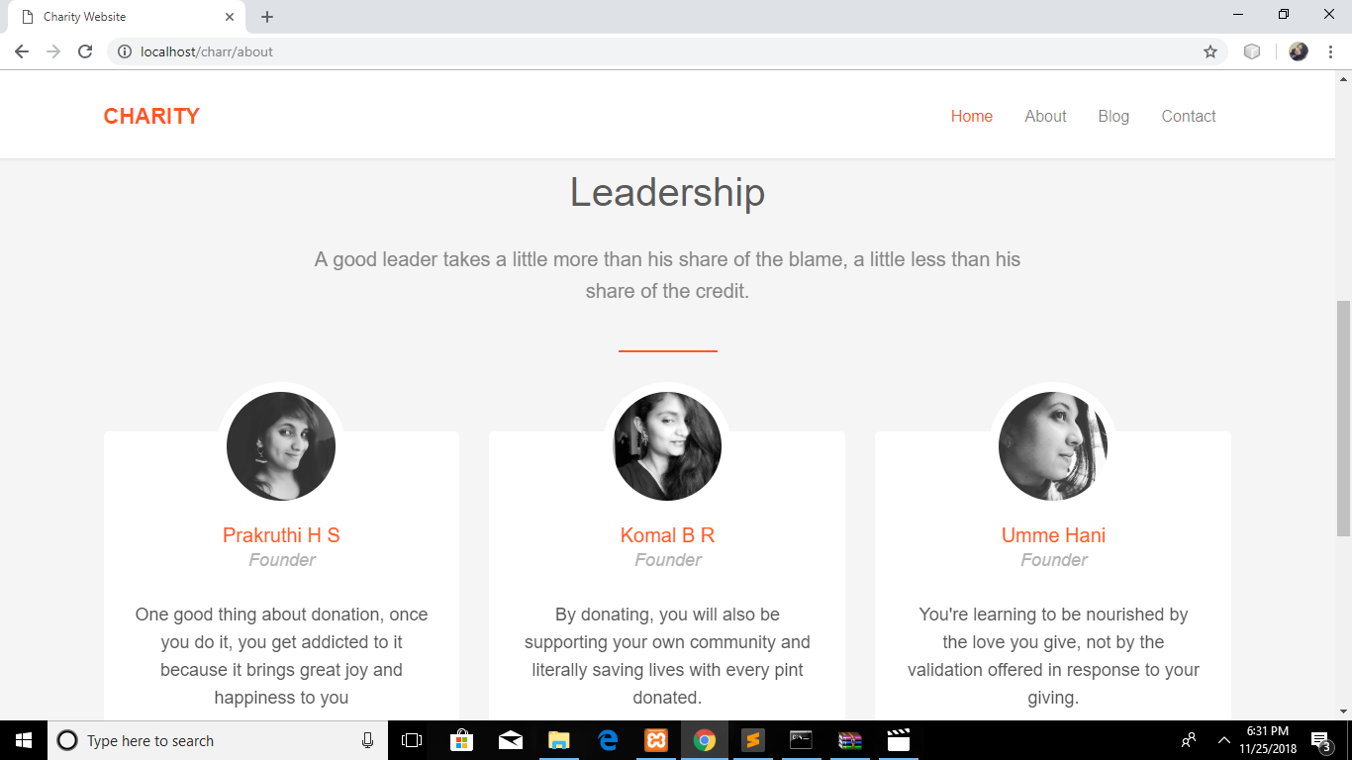

Slide 11
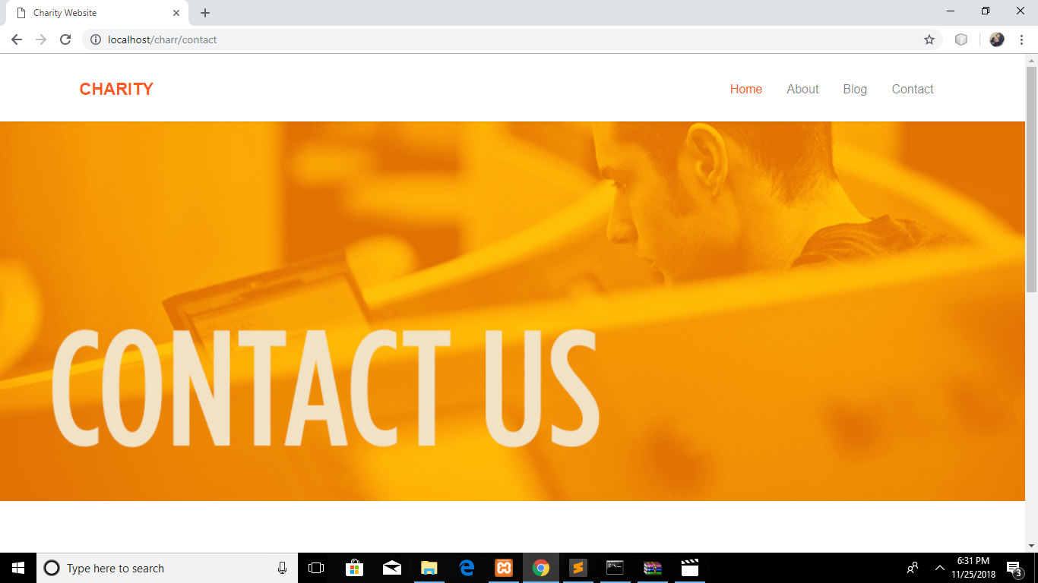

Slide 12
